Slide 1
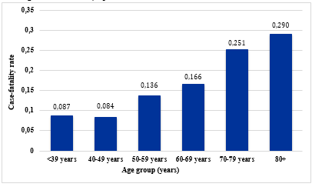
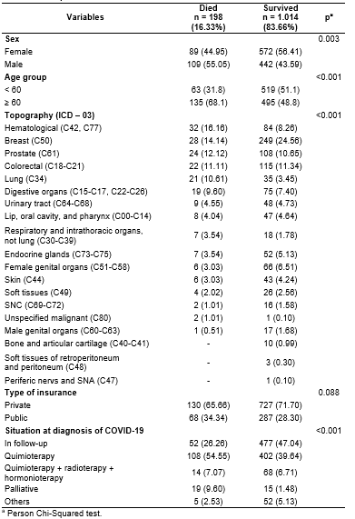
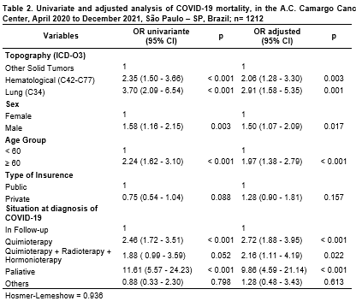
Lethality of COVID-19 infection in cancer patients in A.C. Camargo Cancer Center, 2020 to 2021
Candelária LM¹, Curado MP², Silva DRM^{3,4}, Arantes PE⁵, Fernandes GA²
¹PIBIC Fellowship (CNPq) Conselho Nacional de Desenvolvimento Científico e Tecnológico. São Paulo, SP, Brazil.
²Group of Epidemiology and Statistics on Cancer, AC Camargo Cancer Center, São Paulo, SP, Brazil
³Hospital Cancer Registry, A.C.Camargo Cancer Center, São Paulo, SP, Brazil.
⁴Postgraduate Program in Epidemiology, School of Public Health, University of São Paulo, São Paulo, SP, Brazil.
⁵Brazilian Clinical Research Center – BCRI, São Paulo, SP, Brazil.
Introduction
Table 2. COVID-19 case-fatality rate by cancer histology (ICD-O3) at the A. C. Camargo Cancer Center, April 2020 to December 2021, N=1212 cases, São Paulo – SP, Brazil.
Cancer patients are more susceptible to the aggravation and lethality of COVID-19. Considering the prospect of growth in the number of new cancer cases and the pandemic context it is important to elucidate the factors associated with severe outcomes, such as death, caused by COVID-19 in a specialized cancer treatment center in Brazil. Tha Aim of this study was to analyze the factors associated with death in cancer patients who had COVID-19 as the cause of death in a Brazilian cancer center.
Topography (ICD-O3) | Deaths | Total | Case-fatality rate
Hematological (C42, C77) | 32 | 116 | 0.276
Breast (C50) | 28 | 277 | 0.101
Prostate (C61) | 24 | 132 | 0.182
Colorectal (C18-C21) | 22 | 137 | 0.161
Lung (C34) | 21 | 56 | 0.375
Digestive organs (C15-C17, C22-C26) | 19 | 94 | 0.202
Urinary tract (C64-C68) | 9 | 57 | 0.158
Lip, oral cavity, and pharynx (C00-C14) | 8 | 55 | 0.145
Respiratory and intrathoracic organs, not lung (C30-C39) | 7 | 25 | 0.280
Endocrine glands (C73-C75) | 7 | 59 | 0.119
Female genital organs (C51-C58) | 6 | 72 | 0.083
Skin (C44) | 6 | 49 | 0.122
Soft tissues (C49) | 4 | 30 | 0.133
SNC (C69-C72) | 2 | 18 | 0.111
Unspecified malignant (C80) | 2 | 3 | 0.666
Male genital organs (C60-C63) | 1 | 18 | 0.055
Casuistry and Methods
This is a cohort study conducted from April 2020 to December 2021 at A.C. Camargo Cancer Center (ACCCC), in São Paulo, Brazil. Cases were extracted from the Hospital Cancer Registry and medical records. We calculated the lethality rates of COVID-19 by histology and age group and performed descriptive analysis of the data by absolute and relative frequencies using Pearson's X2 test. Univariate logistic regression analysis was performed, the variables with p<0.20 were selected and entered into the multiple model by the Stepwise Forward technique. The variables that remained in the multiple model were those with p<0.05 and those that contributed to a good fit, the odds ratio (OR) and respective 95% confidence intervals were calculated. Project approved by the Research Ethics Committee under nº 4.236.347.
Results
Figure 1. Case-fatality rate of COVID-19 in oncological patients by age group, at A.C. Camargo Cancer Center, April de 2020 to December 2021, N=1212 cases, São Paulo – SP, Brazil.
A total, 1212 oncology patients between 2020 and 2021 were diagnosed with COVID-19, with a lethality of 16.3% (198), 54.5% were women, 51.9% aged ≥ 60 years, 70.7% were served by supplementary health care, 53.5% were on treatment when diagnosed with COVID-19 (78.5% on chemotherapy).
A total, 1212 oncology patients between 2020 and 2021 were diagnosed with COVID-19, with a lethality of 16.3% (198).
Table 1. Sociodemographic and clinical data of the A.C. Camargo Cancer Center COVID-19 cohort, from April 2020 to December 2021, N=1212 cases, São Paulo – SP, Brazil.
Table 3. Univariate and adjusted analysis of COVID-19 mortality, in the A.C. Camargo Cancer Center, April 2020 to December 2021, N=1212 cases São Paulo – SP, Brazil.
Conclusion
The results of this study reinforce the findings of a previous article that used data from April to August 2020 (Fernandes et al, 2021). The oncology patients who had the highest odds of dying from COVID-19 were those with lung and hematologic cancers, male, age over 60 years, on chemotherapy treatment. Patients in oncologic treatment had a higher lethality when infected by SARS-COV-2. Vaccination of these patients should be reinforced, as well as isolation during treatment, in order to prevent lethal outcomes.
Financier: PIBIC scholarship student nº 154509/2021-3
Contact
Letícia Miliano Candelária | leticiamcandelaria@hotmail.com Gisele Aparecida Fernandes | gisele.fernandes@accamargo.org.br

