Slide 1
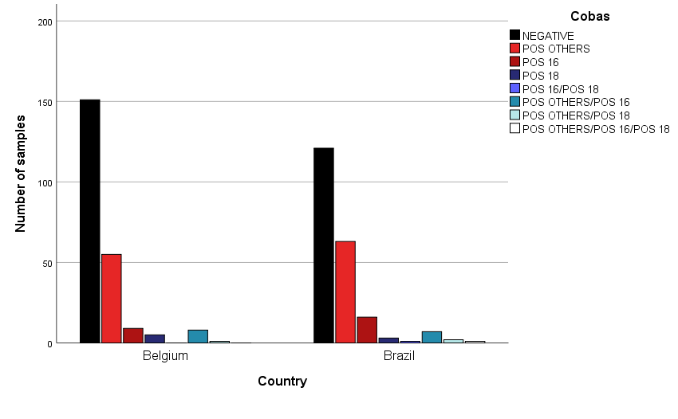
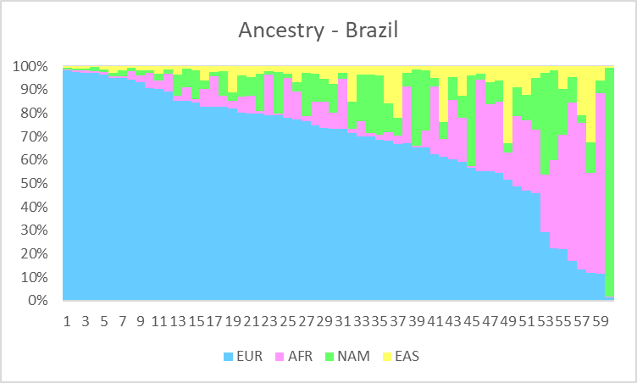
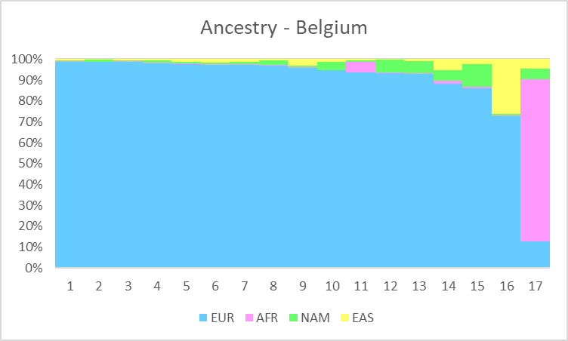
Characteristics of ancestry patterns of multiracial women population with cervical lesions induced by HPV: Preliminary results from H2020 Elevate Study.
Yasmin Medeiros Guimarães¹, Luani Rezende Godoy¹, Tauana Christina Dias¹, Julio Cesar Possati Resende¹, Heleen Vermandere², Olivier Degomme², Ricardo dos Reis¹, Adhemar Longatto-Filho³.
1 – Barretos Cancer Hospital, Barretos, Brazil
2 – Ghent University, Ghent, Belgium
3 – Minho University, Braga, Portugal
Introdução
Resultados
Cervical cancer remains a public health problem worldwide, especially in middle and low-income countries as Brazil. This tumor is caused by the HPV, most notably types 16, 18 and 12 other high-risk types. Currently, studies show the influence of the infected woman's ancestry in the persistence of the HPV infection and the risk of developing cancer. However, in Brazil, the knowledge about the influence of ancestry needs to be explored, as it is a highly admixed population, and so skin color and self-declaration criteria have little reliability to establish these associations. It is also important to investigate whether this difference in persistence caused by the women’s ancestry can change the HPV infection profile in distinct populations. We aim to characterize the genetic ancestry of 500 Brazilian (250) and Belgium (250) women and to associate it with age, cytology status and HPV genotyping data.
Métodos
Ancestry analysis is performed using a set of 46 ancestry-informative markers (AIMs) among the most informative insertion and deletion polymorphisms (INDELs) for each population group. A 46plex PCR is performed and the amplified products are subsequently submitted to capillary electrophoresis in the ABI 3500 xL sequencer (Applied Biosystems). The electropherograms are analyzed and the genotypes are automatically assigned with GeneMapper v4.1 (Applied Biosystems). The proportions of ancestry are assessed using the Structure v2.3.3 software, considering the four main parental population groups: Native Americans, Europeans, Africans, and Asians as possible contributors to the current genetic background of the general population. For HPV genotyping, Cobas® 4800 HPV Test (Roche) is used. Statistical analysis will be performed with the Software SPSS 25.0 (IBM Corp) and only results with a p value <0.05 will be considered significant.
Inserir Figuras
Ancestry proportion of the 63 Brazilian cases already completely analyzed. EUR(European)= 67%, AFR(African)= 15%; NAM(Native American)=12% and EAS(Asian)=6%.
Resultados
So far, 239 cases were fully analyzed for genetic ancestry. The estimate proportion of ancestry for Brazilian women is European=67%, African=15%, Native American=12% and Asian=6%. For Belgium women, the estimation is European=89%, African=5%, Native American=3% and Asian=3%. Regarding HPV genotyping, 374 samples were already tested. For the 194 Brazilian samples, 57.3% were negative; among the positive ones, 28.6% were positive for the other 12 HPV high-risk types, 6.8% were positive for HPV16, 1.6% HPV 18, 3.6% coinfection of others and 16, 1% coinfection of others and 18, 0.5% coinfection of 16 and 18, and 0.5% coinfection of other, 16 and 18. For the 180 Belgium samples, 68.8% were negative; among the positive ones, 18.8% were positive for the other 12 high-risk HPV types, 3.1% positive for HPV16, 1% for HPV18 and 1.6% coinfection of others and 16.
Ancestry proportion of the 17 Belgium cases already completely analyzed. EUR (European)=89%, AFR (African)=5%; NAM (Native American)= 3% and EAS (Asian)= 3%.
Conclusões
In near future, we expect to verify if the HPV infection profile of Brazilian and Belgium women are associated with statistically significant differences when clustered by genetic ancestry, age, and cytology status.
Contato
E-mail: yasminmguimaraes@outlook.com / Telefone: (17) 3321-6600 Ramal 7093

